Slide 1

MOVIE RECOMMENDER SYSTEM

Slide 2

Business Problem
Collaborative Filtering: Predict user preferences based on similar users.
Content-Based Filtering: Recommend items similar to what a user has liked before.
3.Discovery Challenge : Users struggle to discover new movies that align with their tastes especially when they are unaware of rich hidden movies

Slide 3

GOALS & OBJECTIVES
1.Enhance Personalization
2.Improve User Experience
3.Drive movie engagement
4.Ensure scalability and robustness

Slide 4
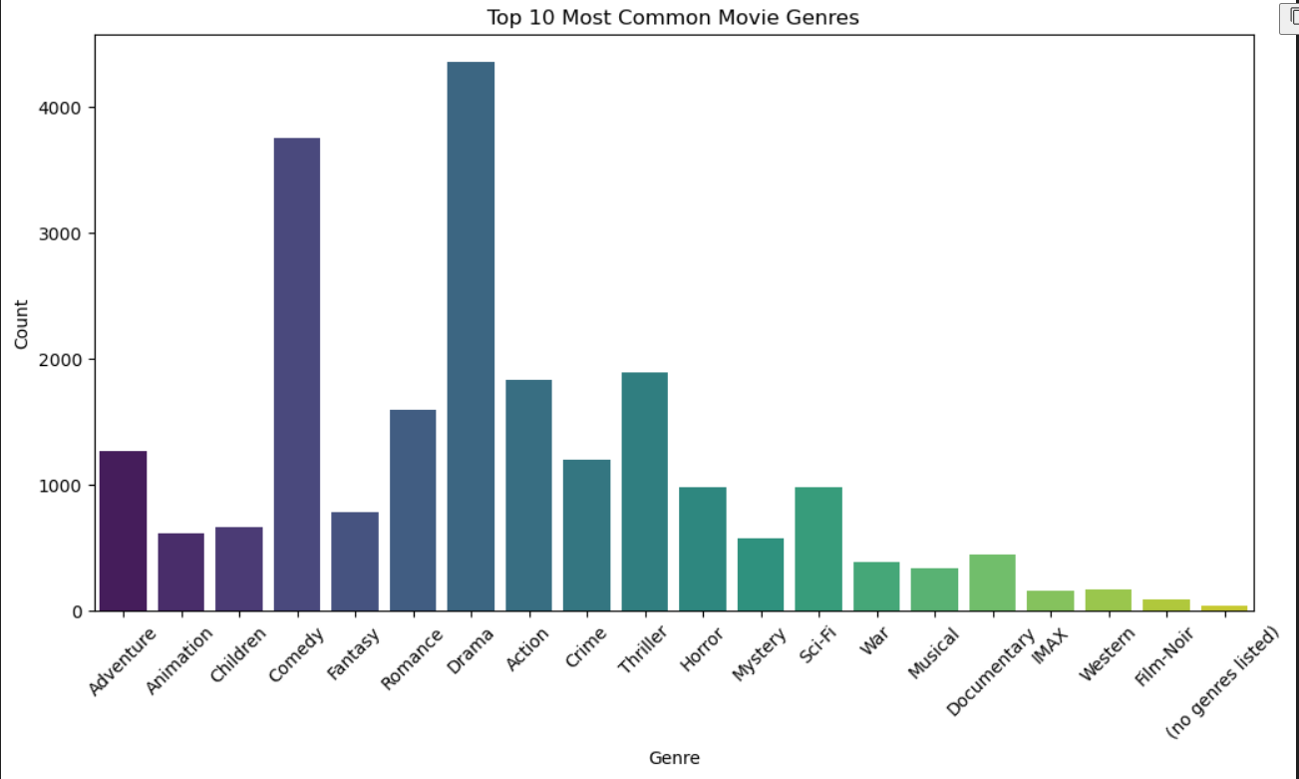
Visualization

Slide 5
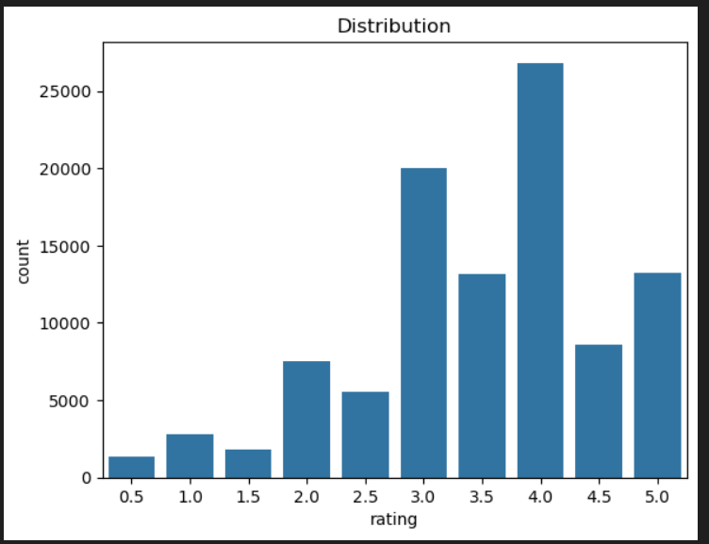

Slide 6

EXPLORATORY DATA ANALYSIS (EDA)
The dataset shows a skewed rating distribution, with most movies receiving higher ratings, particularly around 4 stars.
Drama is the most watched genre, followed by Comedy and Action, while Thriller, Adventure, and Romance have moderate popularity.
The most-rated movies, such as Hollywood Chainsaw Hookers and Calcium Kid, significantly impact collaborative filtering recommendations. Highly rated genres include Film-Noir, War, Documentary, Crime, and Drama, meaning users who favor these genres are likely to receive similar recommendations.

Slide 7
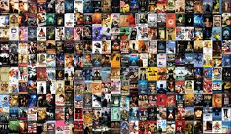
Conclusion
Rating distribution shows a positive skew, with most movies receiving 4-5 star ratings
Both collaborative and content-based filtering methods demonstrated effectiveness in generating recommendations
The combination of both approaches provides a more robust recommendation system
The models show promise in capturing user preferences and suggesting relevant content

